Slide 1
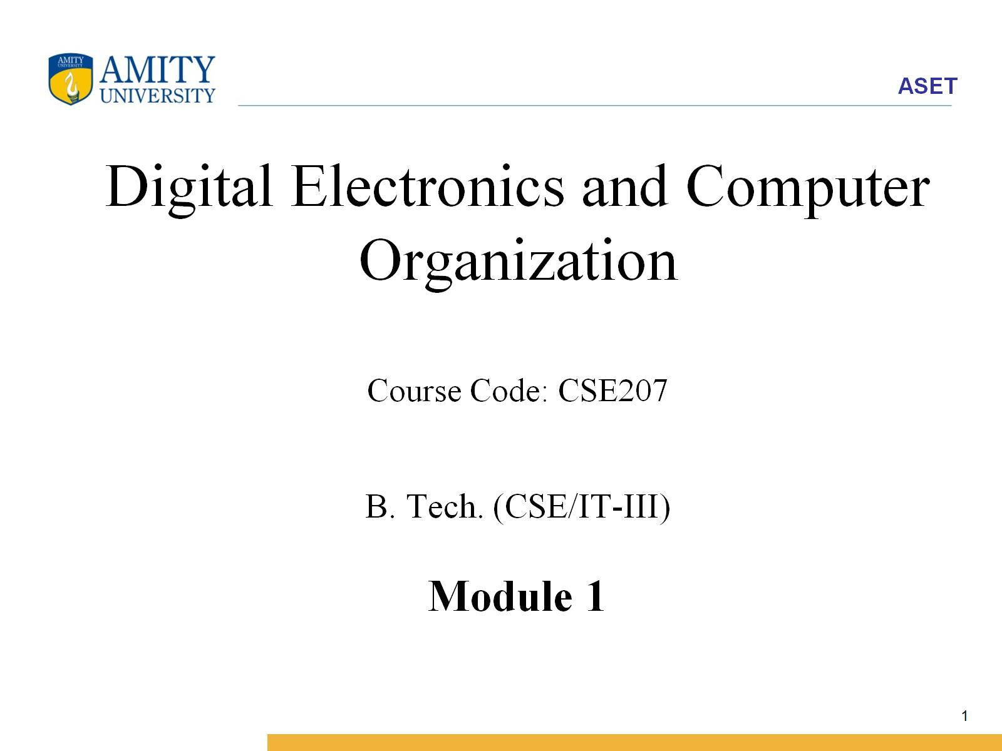
Digital Electronics and Computer Organization Course Code: CSE207 B. Tech. (CSE/IT-III) Module 1

Slide 2
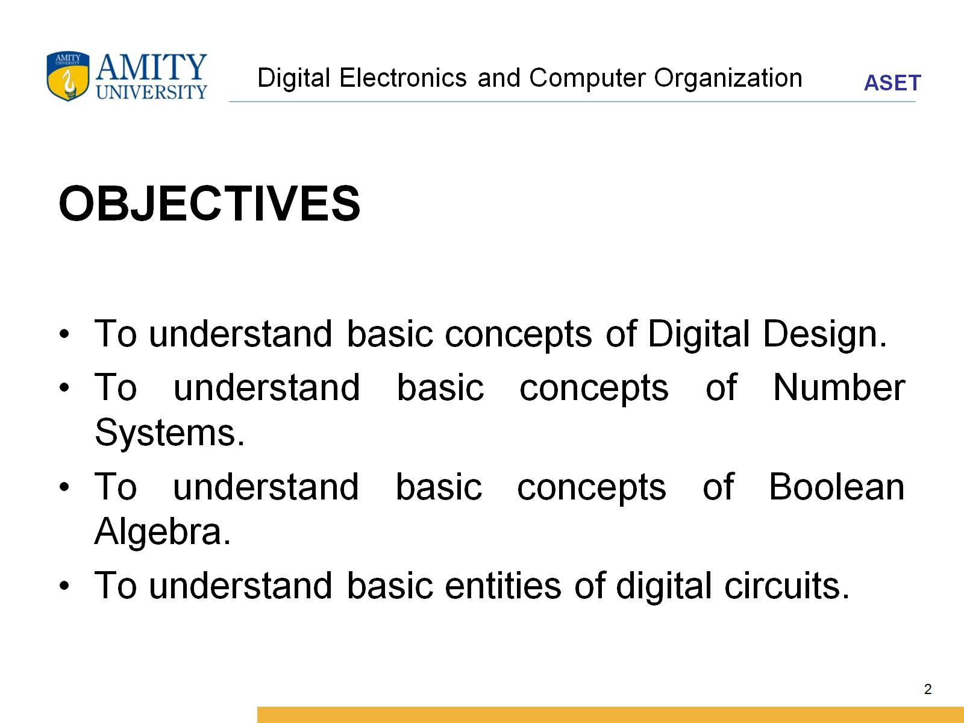
Digital Electronics and Computer Organization

Slide 3
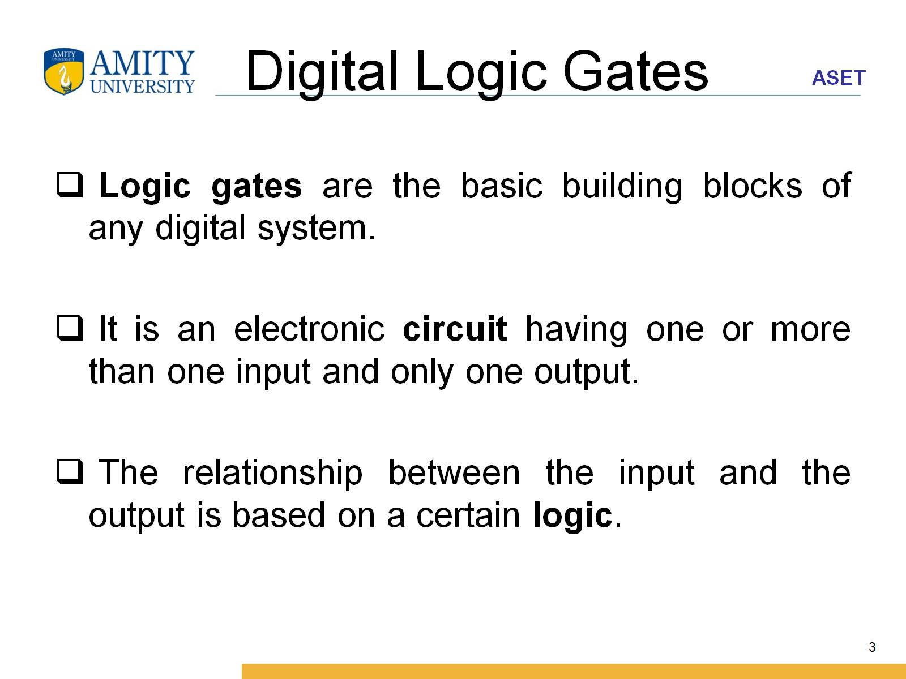
Digital Logic Gates

Slide 4
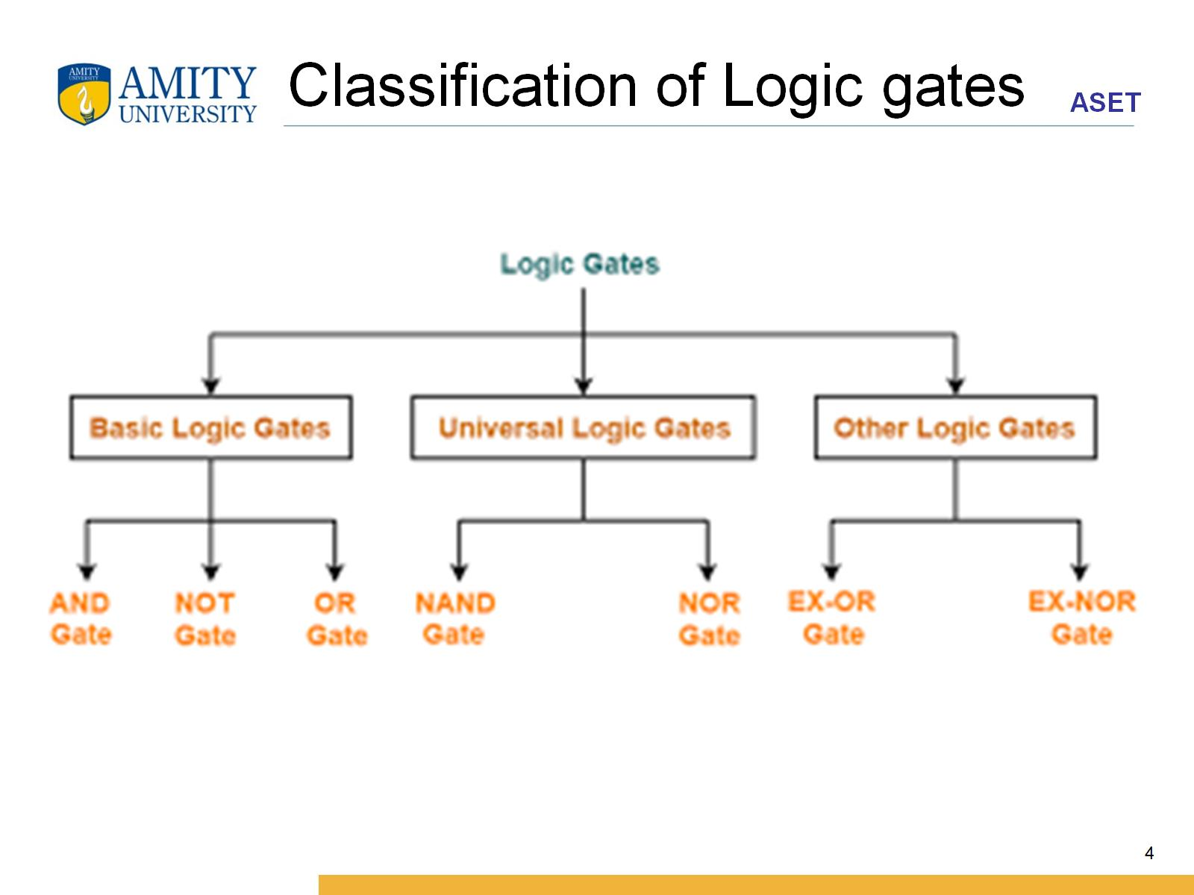
Classification of Logic gates

Slide 5
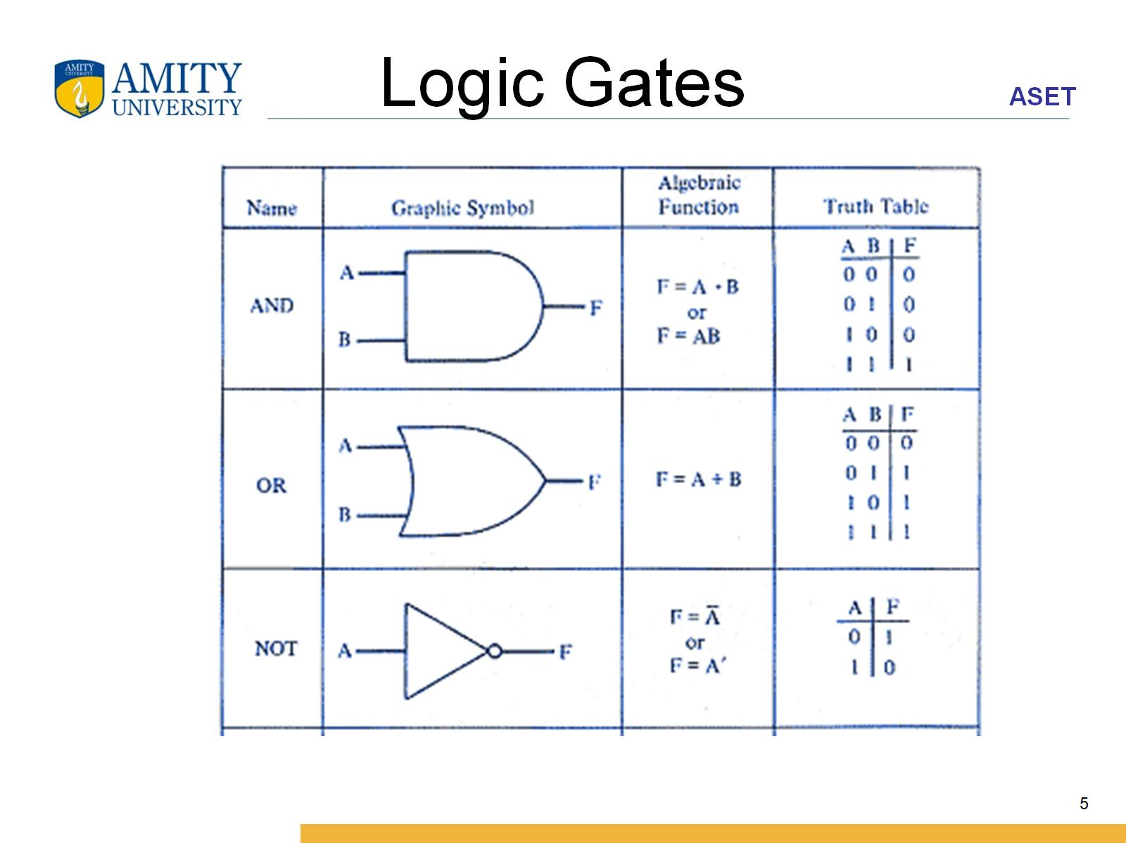
Logic Gates

Slide 6
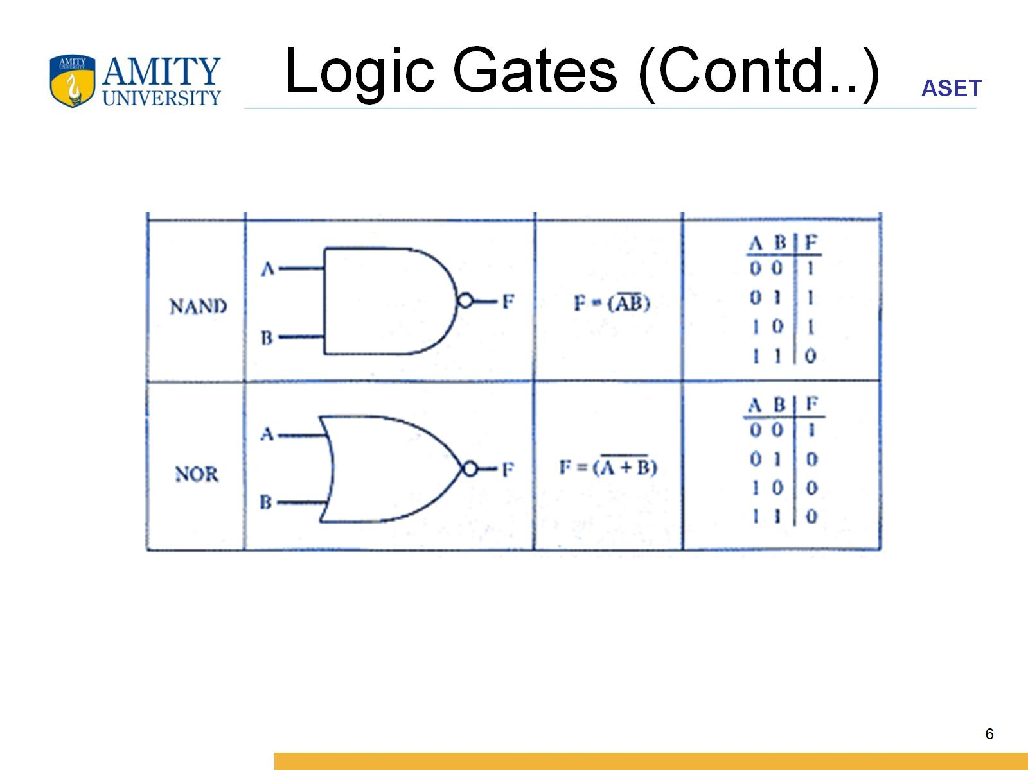
Logic Gates (Contd..)

Slide 7
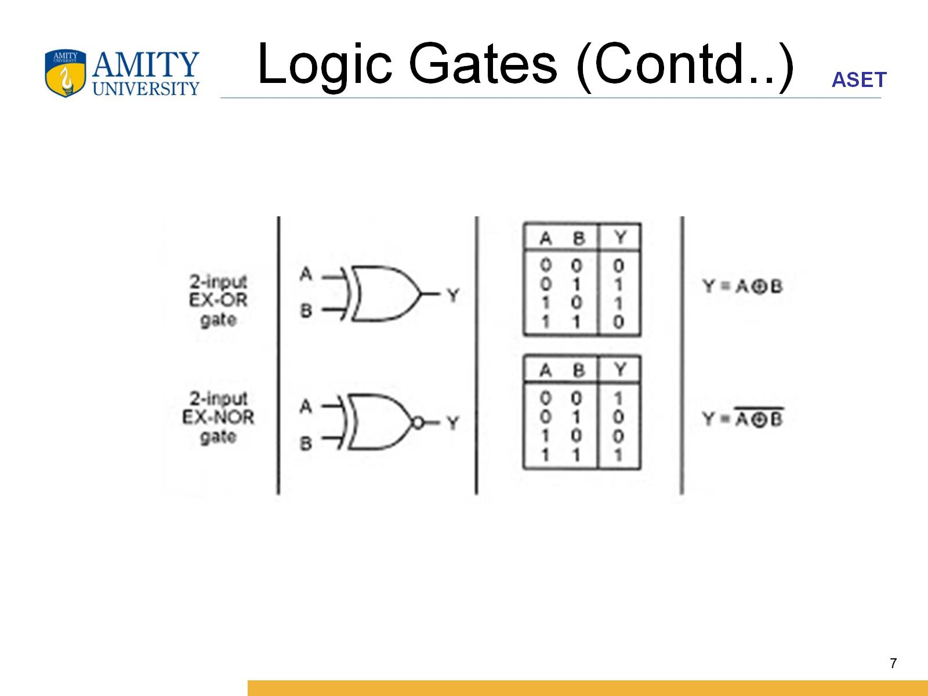
Logic Gates (Contd..)

Slide 8
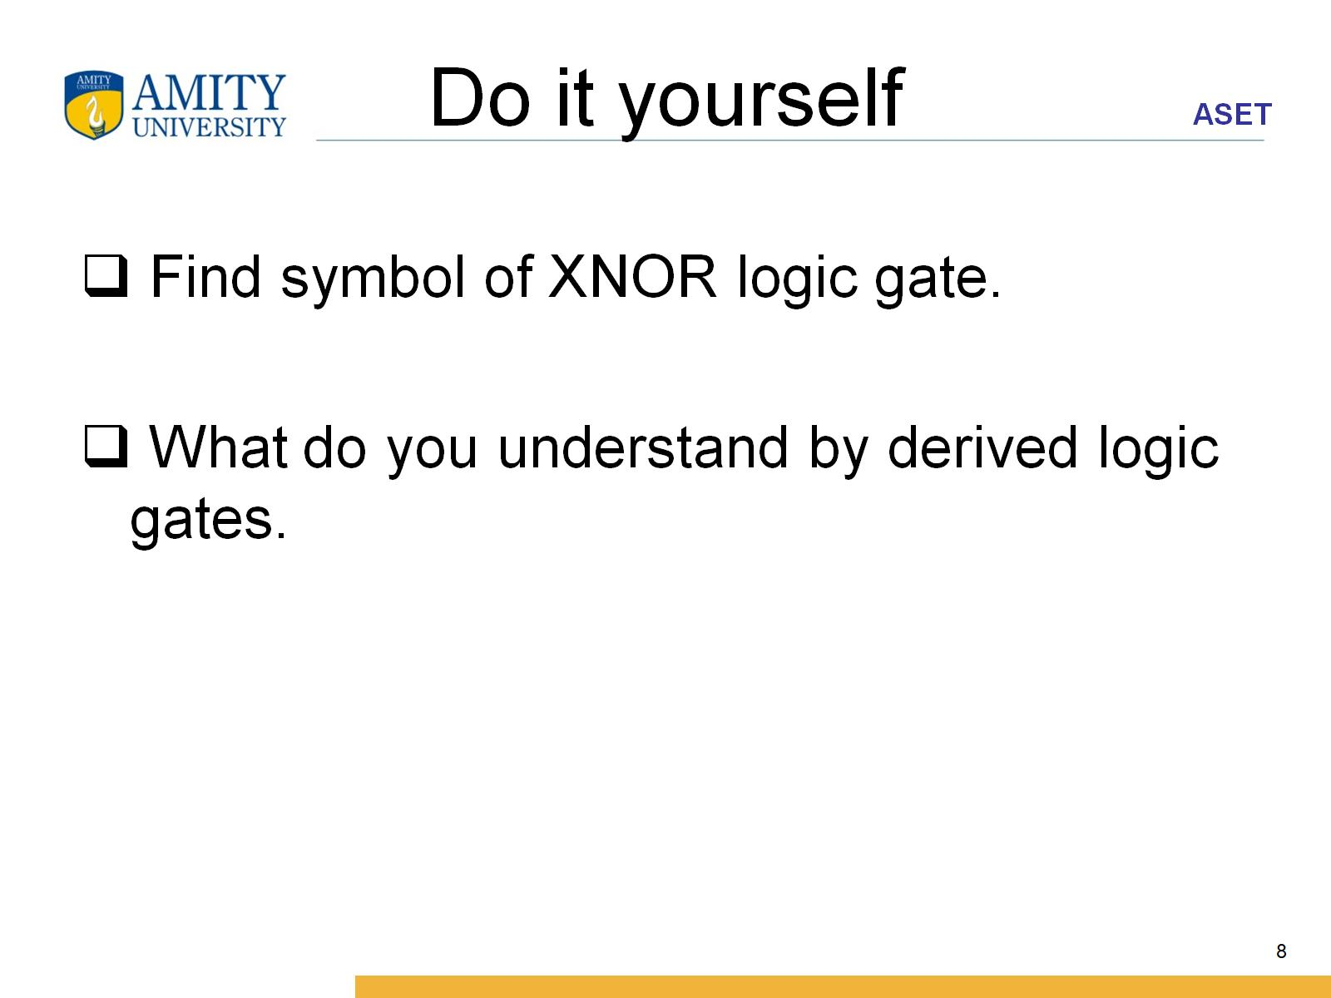
Do it yourself

Slide 9
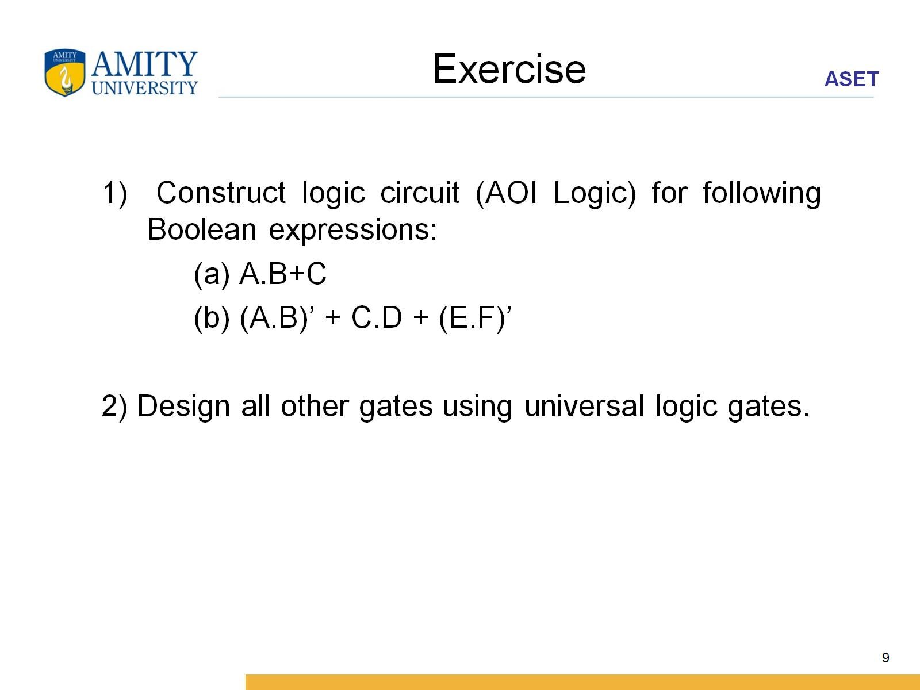
Exercise

